Slide 1
Mappings
CSE 2050
Ahmad Jbara
University of Connecticut

Slide 2
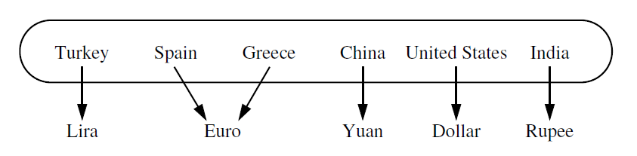
Mappings
A mapping is an association between two sets of things
It associates a value to a key (key-value pair)
Keys must be unique
In Python, dictionary (dic) is the data type for mapping
We will implement our own dictionary

Slide 3
The Mapping ADT
A mapping is a collection of key-value pairs, keys are unique
It supports the following methods:
Operation | Description
Map() | creates a new empty Map
get(k) | Returns the value associated with the key k. Exception is raised if k does not exist (KeyError)
put(k, v) | Adds the key-value pair (k, v) to the mapping
The above method are generally implemented using __getitem__ and __setitem__ respectively.

Slide 4
Implementation using list
class ListMappingSimple:
def __init__(self):
self._entries = []
def put(self, key, value):
for e in self._entries:
if e.key == key:
e.value = value
return
self._entries.append(Entry(key, value))
def get(self, key):
for e in self._entries:
if e.key == key:
return e.value
raise KeyError
class Entry:
def __init__(self, key, value):
self.key = key
self.value = value
def __str__(self):
return str(self.key) + " : " +
str(self.value)

Slide 5
Adding more methods
class ListMapping:
def __init__(self):
self._entries = []
def put(self, key, value):
e = self._entry(key)
if e is not None:
e.value = value
else:
self._entries.append(Entry(key, value))
def get(self, key):
e = self._entry(key)
if e is not None:
return e.value
else:
raise KeyError

Slide 6
Adding more methods
class ListMapping:
def _entry(self, key):
for e in self._entries:
if e.key == key:
return e
return None
def __str__(self):
return str([str(e) for e in self._entries])
def __getitem__(self, key):
return self.get(key)
def __setitem__(self, key, value):
self.put(key, value)
def __len__(self):
return len(self._entries)

Slide 7
Adding more methods
class ListMapping:
def __contains__(self, key):
if self._entry(key) is None:
return False
else:
return True
def __iter__(self):
return (e.key for e in self._entries)
def values(self):
return (e.value for e in self._entries)
def items(self):
return ((e.key, e.value) for e in self._entries)

Slide 8
It’s too slow
Our goal
To get constant-time operations as in Python dict
Currently
Linear time to put, get, and membership testing
Because we need to iterate through the list

Slide 9
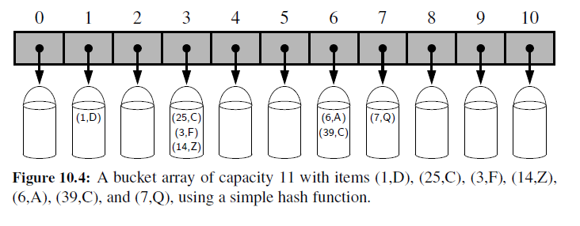
A new idea
Imagine we have many small lists instead of long one
List of lists or list of ListMapping (called buckets)
Then, for every given key we just need to find (quickly) which short list (bucket) we need for this key
So, given a key we want to find a bucket in the list.
That is, find its index
For a given key, we want to find a number (index)

Slide 10
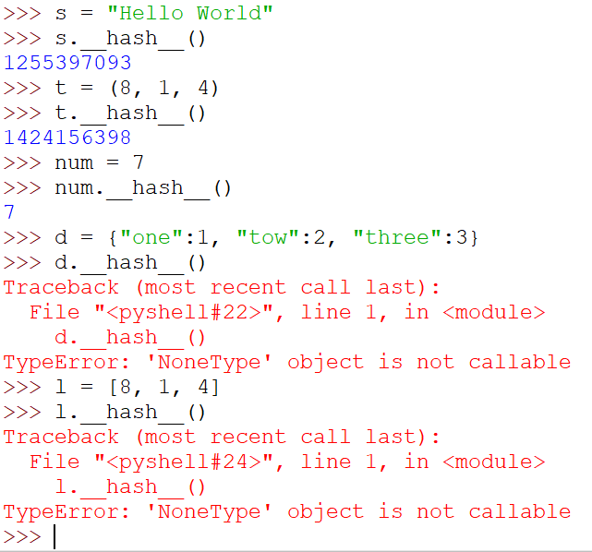
Hash functions
A hash function takes a key and returns an integer
Most classes in Python implement the __hash__ (hash) method that does this for hashable objects of that class

Slide 11
Implementation using hash
class HashMappingSimple:
def __init__(self):
self._size = 100
self._buckets = [ListMapping() for i in range(self._size)]
def __setitem__(self, key, value):
m = self._bucket(key)
m[key] = value
def __getitem__(self, key):
m = self._bucket(key)
return m[key]
def _bucket(self, key):
return self._buckets[hash(key) % self._size]
Collision occurs when two keys are placed in the same bucket

Slide 12
How many buckets?
class HashMapping:
def __init__(self, size = 2):
self._size = size
self._buckets = [ListMapping() for i in range(self._size)]
self._length = 0
def __setitem__(self, key, value):
m = self._bucket(key)
if key not in m:
self._length += 1
m[key] = value
if self._length > self._size:
self._double()
def __getitem__(self, key):
m = self._bucket(key)
return m[key]

Slide 13
How many buckets? Doubling & rehashing
class HashMapping:
def _bucket(self, key):
return self._buckets[hash(key) % self._size]
def _double(self):
oldbuckets = self._buckets
self._size *= 2
self._buckets = [ListMapping() for i in range(self._size)]
for bucket in oldbuckets:
for key, value in bucket.items():
m = self._bucket(key)
m[key] = value
def __len__(self):
return self._length

Slide 14
Factoring out a superclass - inheritance
We have two implementations of the same ADT
Mapping is the ADT
ListMapping is one implementation
HashMapping is the other implementation
There are methods that we implemented twice
It makes sense to avoid duplicating common parts
Inheritance helps to do that

Slide 15
Factoring out a superclass - inheritance
Mapping
ListMapping
HashMapping
Common part
Common part

Slide 16
Factoring out a superclass - inheritance
def __contains__(self, key):
try:
self.get(key)
except KeyError:
return False
return True
Mapping
ListMapping
HashMapping
def __contains__(self, key):
try:
self.get(key)
except KeyError:
return False
return True
def __contains__(self, key):
try:
self.get(key)
except KeyError:
return False
return True
X
X

Slide 17
Factoring out a superclass - inheritance
def __contains__(self, key):
try:
self.get(key)
except KeyError:
return False
return True
def get(self, key):
Mapping
raise NotImplemented
ListMapping
HashMapping
def get(self, key):
e = self._entry(key)
if e is not None:
return e.value
else:
raise KeyError
def get(self, key):
bucket = self._bucket(key)
return bucket[key]

Slide 18
Factoring out a superclass - inheritance
class Mapping:
def get(self, key):
raise NotImplemented
def put(self, key, value):
raise NotImplemented
def __len__(self):
raise NotImplemented
def _entryiter(self):
raise NotImplemented
def __iter__(self):
return (e.key for e in self._entryiter())
def values(self):
return (e.value for e in self._entryiter())
def items(self):
return ((e.key, e.value) for e in self._entryiter())
def __contains__(self, key):
try:
self.get(key)
except KeyError:
return False
return True
def __getitem__(self, key):
return self.get(key)
def __setitem__(self, key, value):
self.put(key, value)
def __str__(self):
return "{%s}" % (", ".join([str(e) for e in self._entryiter()]))

Slide 19
Factoring out a superclass - inheritance
class ListMapping(Mapping):
def __init__(self):
self._entries = []
def put(self, key, value):
e = self._entry(key)
if e is not None:
e.value = value
else:
self._entries.append(Entry(key, value))
def get(self, key):
e = self._entry(key)
if e is not None:
return e.value
else:
raise KeyError
def _entry(self, key):
for e in self._entries:
if e.key == key:
return e
return None
def _entryiter(self):
return iter(self._entries)
def __len__(self):
return len(self._entries)

Slide 20
Factoring out a superclass - inheritance
class HashMapping(Mapping):
def __init__(self, size = 100):
self._size = size
self._buckets = [ListMapping() for i in range(self._size)]
self._length = 0
def _entryiter(self):
return (e for bucket in self._buckets for e in bucket._entryiter())
def get(self, key):
bucket = self._bucket(key)
return bucket[key]
def put(self, key, value):
bucket = self._bucket(key)
if key not in bucket:
self._length += 1
bucket[key] = value
if self._length > self._size:
self._double()
def __len__(self):
return self._length
def _bucket(self, key):
return self._buckets[hash(key) % self._size]
def _double(self):
oldbuckets = self._buckets
self.__init__(self._size * 2)
for bucket in oldbuckets:
for key, value in bucket.items():
self[key] = value

Slide 21
Back to dictionaries and hashable objects
Allows to map a set of unique keys to values
Only hashable objects can be used as keys
Object is hashable:
If it has a hash value that never changes
Can be compared to others
Every built-in immutable object in Python is also hashable
Mutable types such as: list, dictionary, set are not hashables
Cannot be used as keys in dictionaries

Slide 22
Protocol that defines hashable
This protocol consists of two methods:
__hash__
method that returns a hash value
Default for user-defined classes is based on object id
__eq__
method that compares equality between two object
Default for user-defined objects is false except comparing an object with itself.
Two objects that are compared to be equal MUST have the same hash value
The reverse does not need to be true

Slide 23
Object equality
You have to implement __eq__(self, other) method
Returns True if self is equal to other, False otherwise.
Raises an exception if __eq__ does not how to compare between self and other
Default behavior of __eq__ returns True just if you compare an object with itself.
Two objects with same content but different ids will yield False
Two references that point to the same object will yield True

Slide 24
Object hashes
An object hash is a number that represents the value of the object
Can be obtained using the hash(object) method
The built-in hash calls the __hash__ method
This is possible if the object is hashable

Slide 25
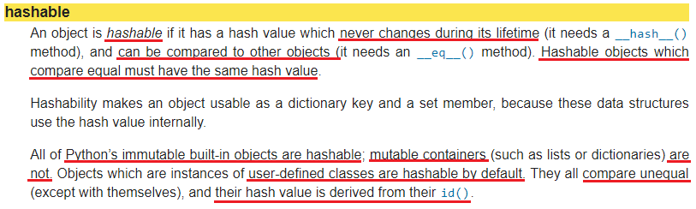
Hashable object

